Slide 1
Automated Pizza Locker
Design Review
The Neatest ECE Team (sd22p10)
Annie Liu, Damian Huerta, David Wechsler, Leah Jackson

Slide 2
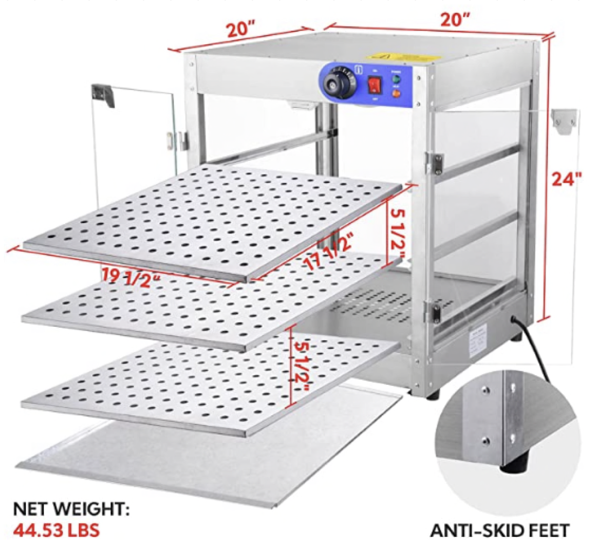
Locker
Temperature
Adjustable, controllable
86° to 230°
Material
Metal is durable
But also expensive
Metal oven + heating element = good choice
Pizza Box Dimensions – XL
16 inches ​​
2inches ​​
16 inches ​​

Slide 3
Locker

Slide 4
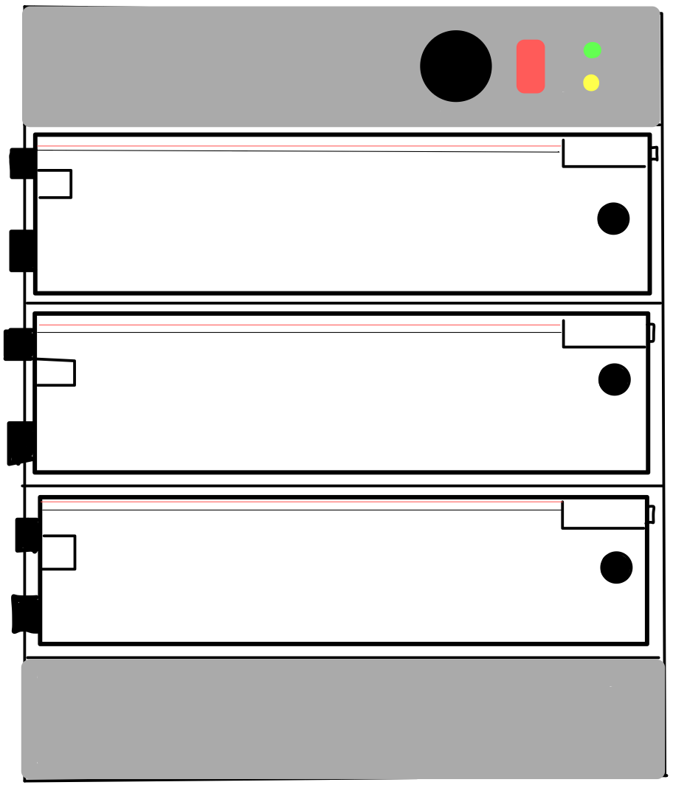
Locker Design

Slide 5
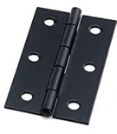
Locker Design
Door Hinge

Slide 6
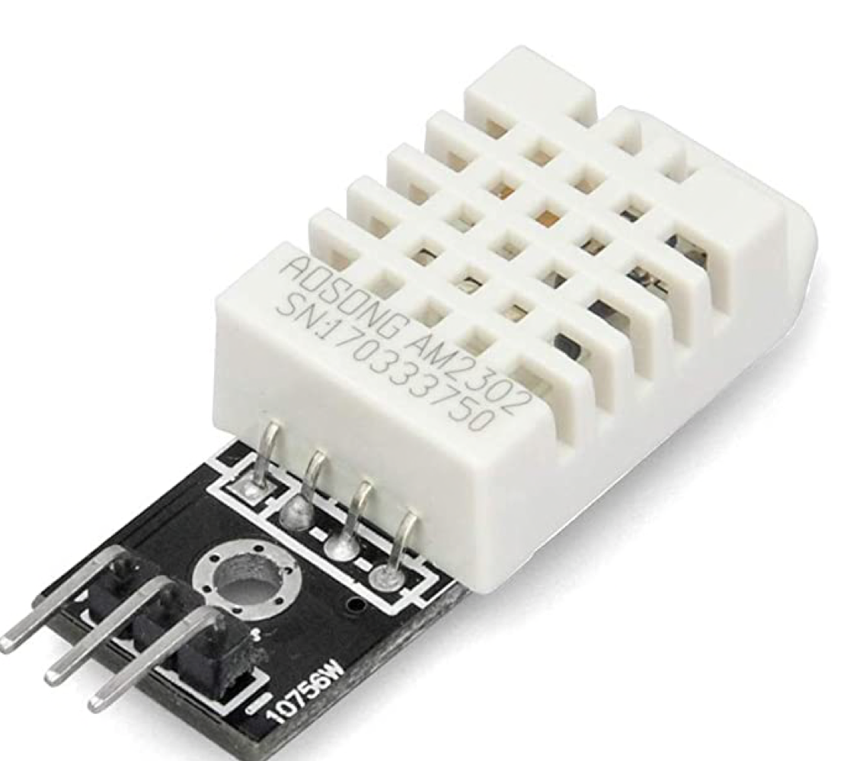
Locker Design
Door Hinge
Temperature Sensor

Slide 7
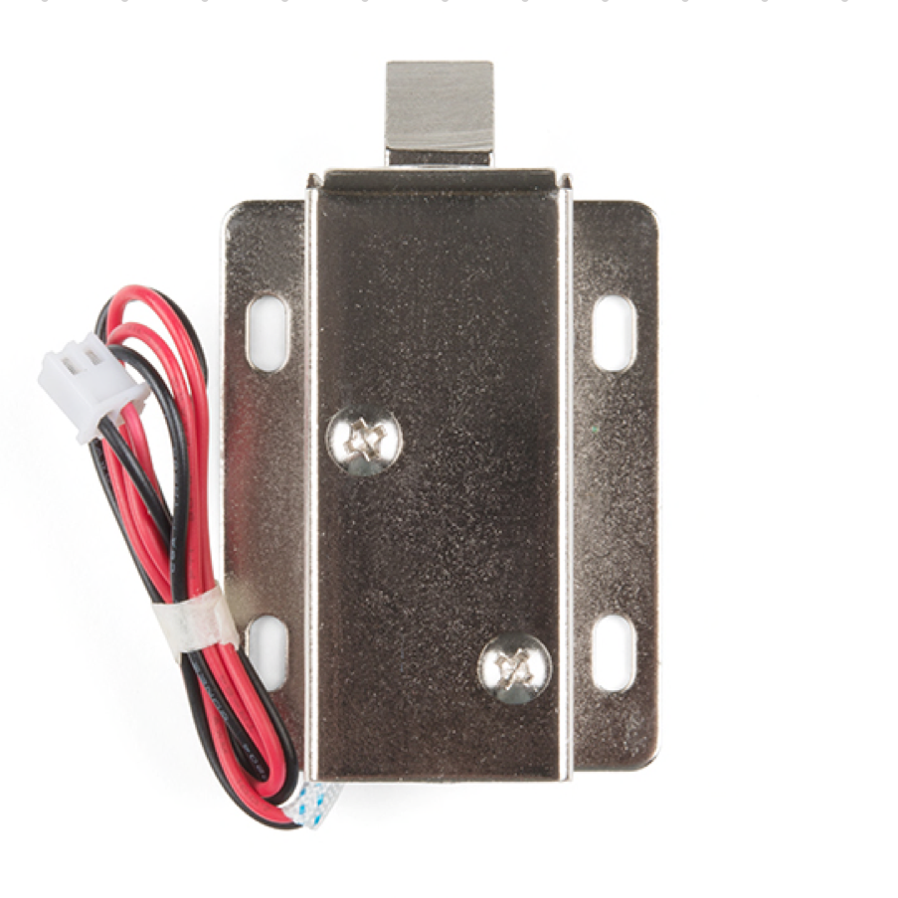
Locker Design
Door Hinge
Solenoid Lock
Temperature Sensor

Slide 8
Locker Design
Door Hinge
Solenoid Lock
Doorknob
Temperature Sensor

Slide 9
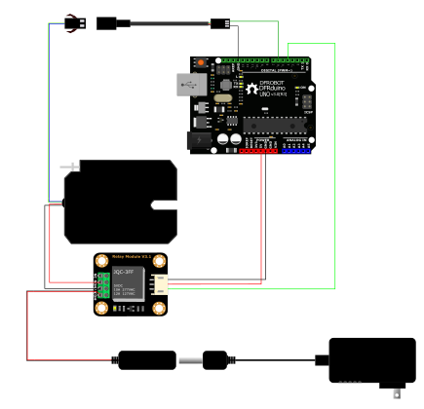
Solenoid Subsystem
Raspberry Pi
Solenoid Lock
Relay
Power Supply

Slide 10
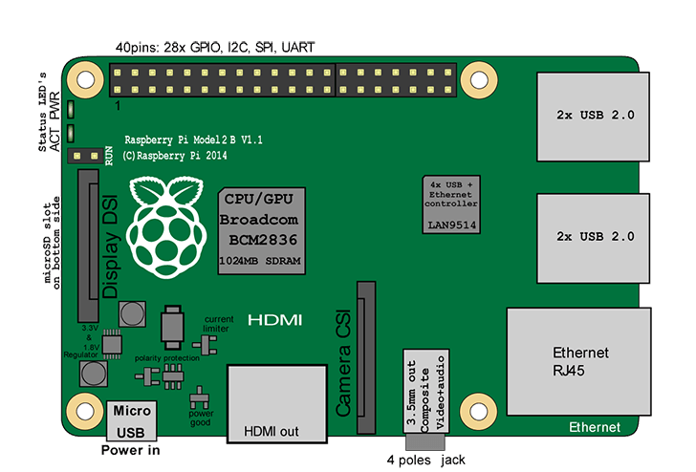
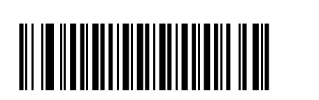
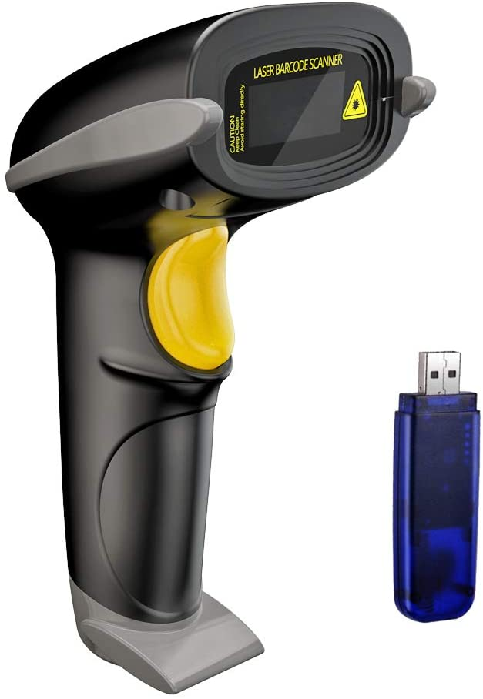
Barcode Scanner Subsystem
barcodes = {"5418762109345": locker #}
lockers= {"locker #": GPIO Pin #}

Slide 11
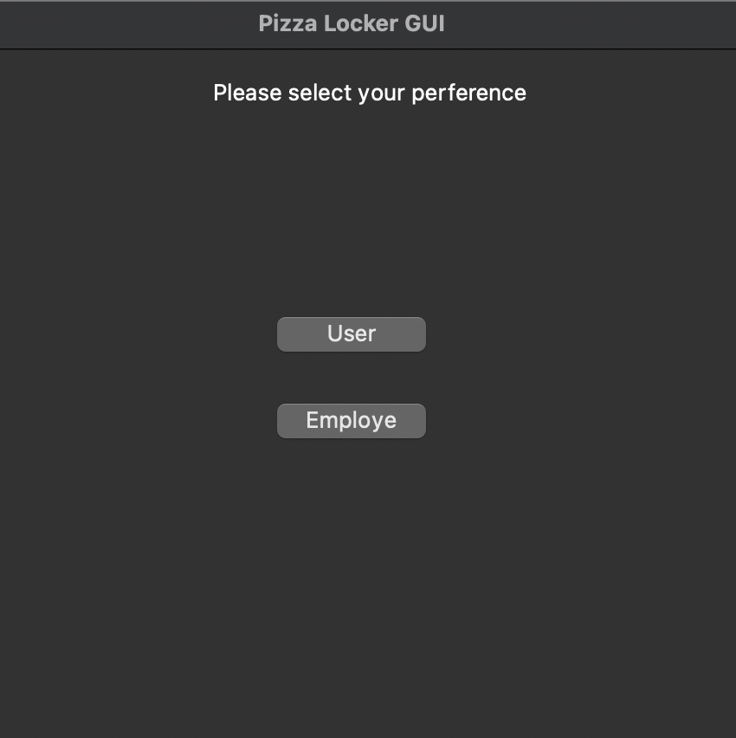
Micro-Controller Sensors/GUI
Running on python3 virtual environment
Utilizing PyQt5 GUI library
Selecting preference prompts barcode read and display of barcode ASCII representation
Barcode read code still in development
Utilizing evdev python library

Slide 12
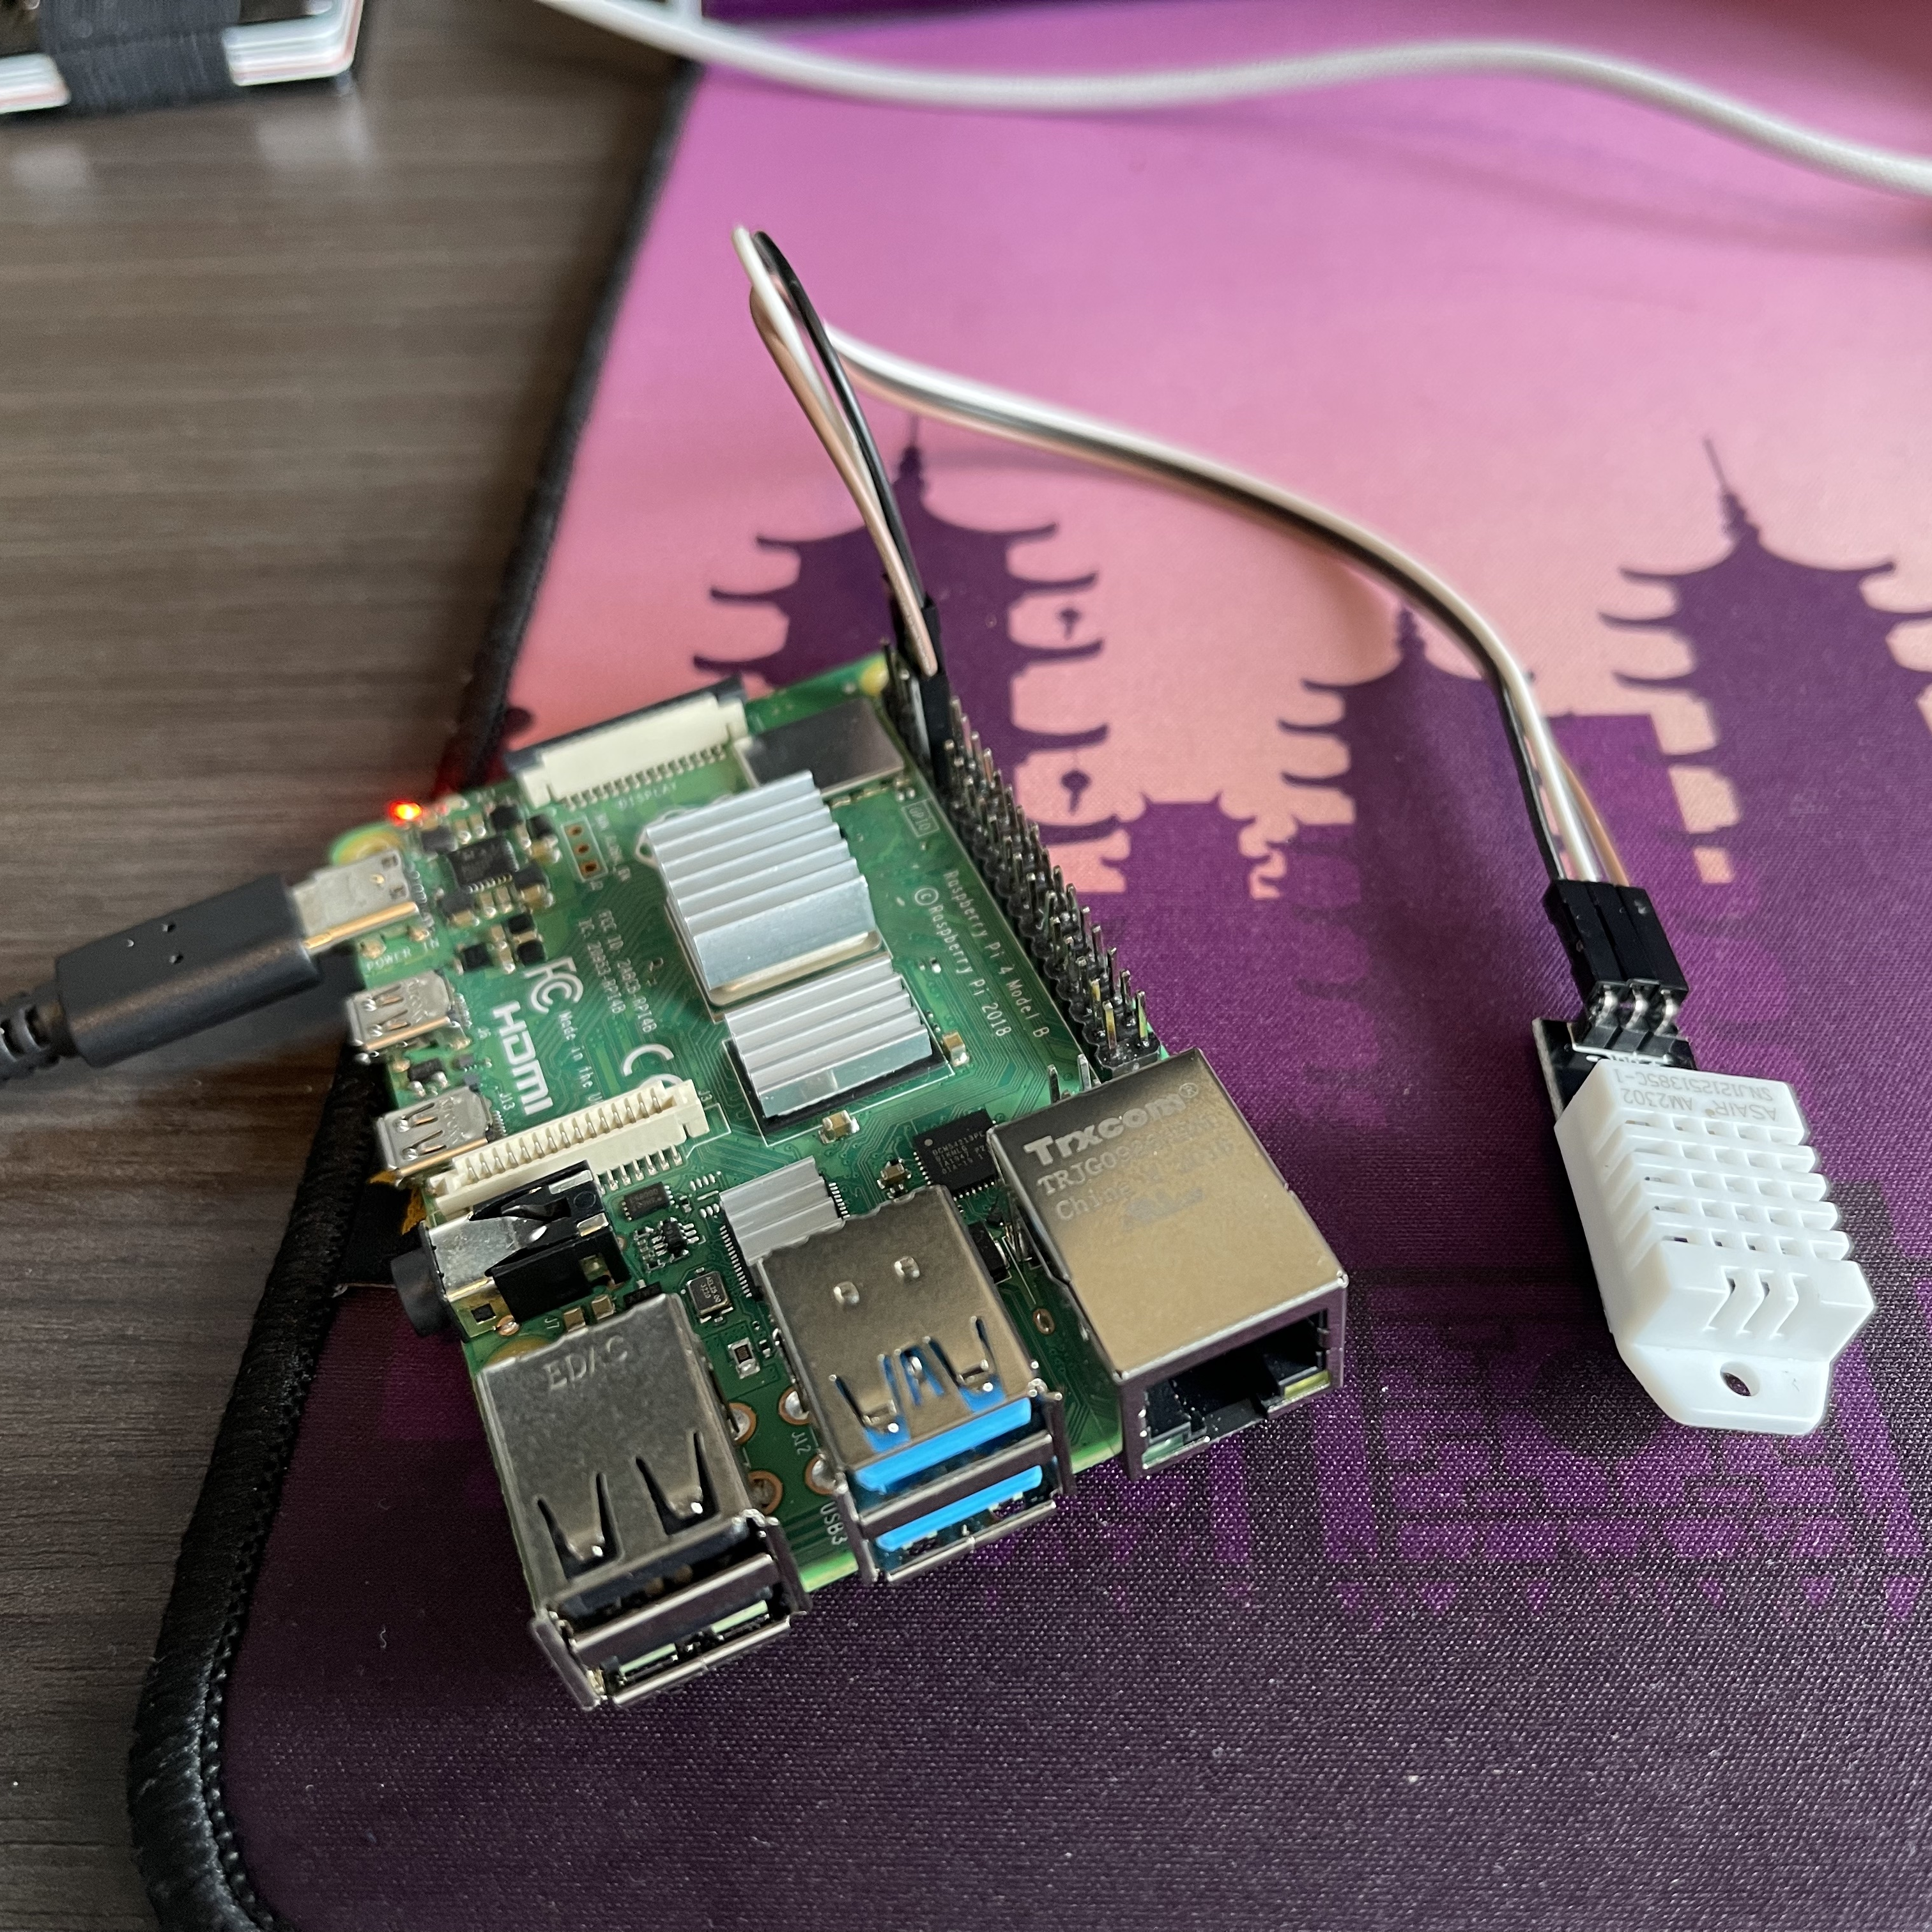
Micro-Controller/GUI
Temperature sensor uses 5V, ground, and 1 GPIO pin
Measurements read using RPi.GPIO python library.
Eventually data will be sent to user application periodically

Slide 13
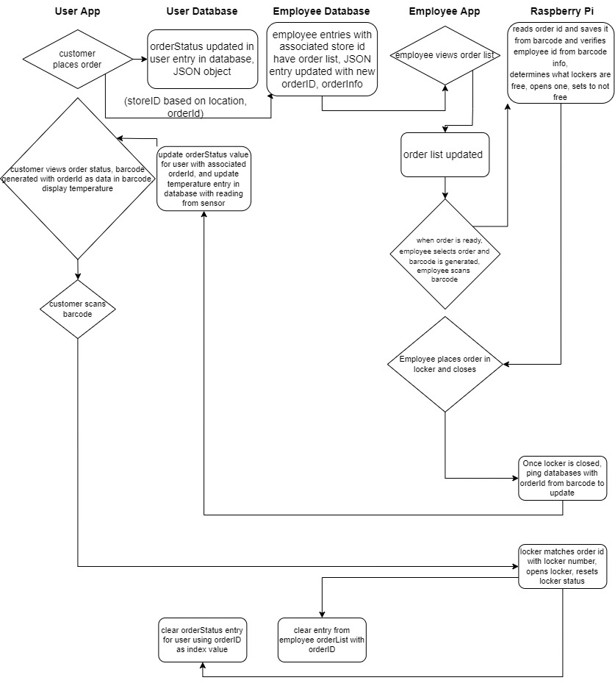
Software Flow Diagram

Slide 14
Software Flow Diagram
A
B
C

Slide 15
Software Flow Diagram A

Slide 16
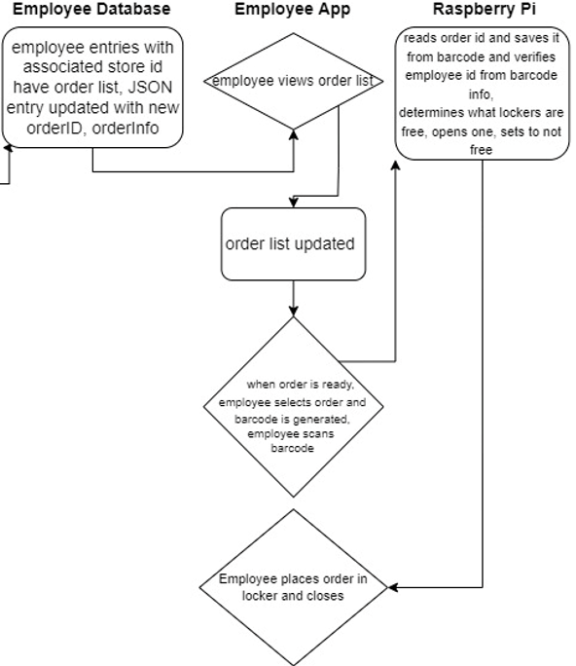
Software Flow Diagram B

Slide 17
Software Flow Diagram C

Slide 18
Software Design
Communication between Application and Raspberry Pi
AWS API Gateway
Lambda Functions for API Requests
DynamoDB, a NoSQL database, for user/employee information
User/Employee Application
React Native, a cross-platform development tool
React Native Javascript will handle interface and application interaction with AWS services

Slide 19
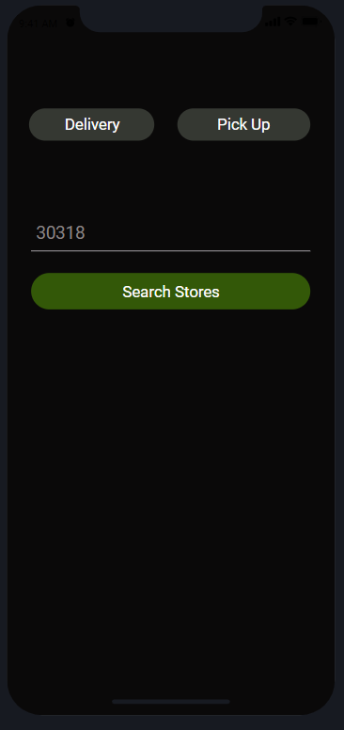
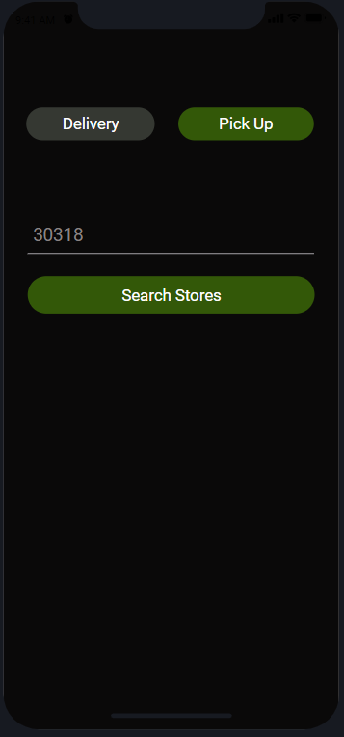
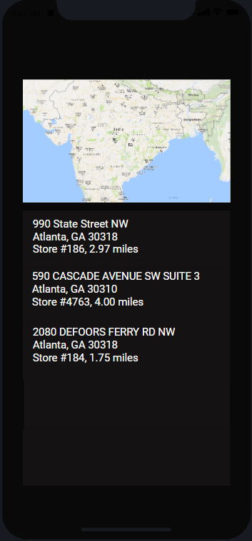
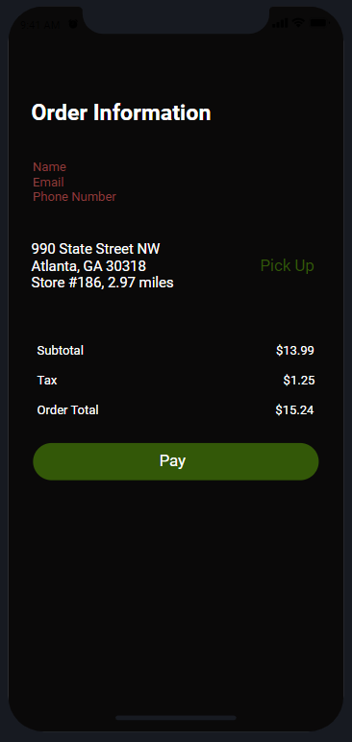
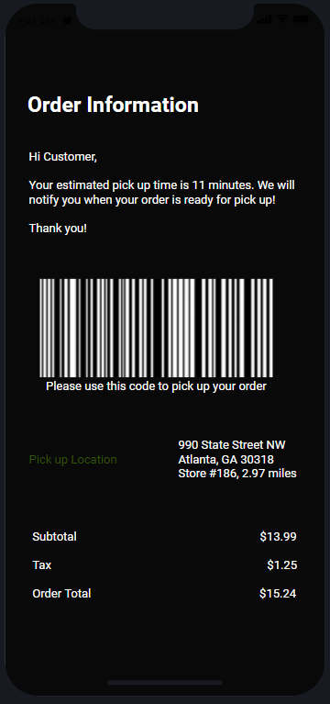
UI Design

